Slide 1
HerbalScience 2020 Sustainability KPIs

Slide 2
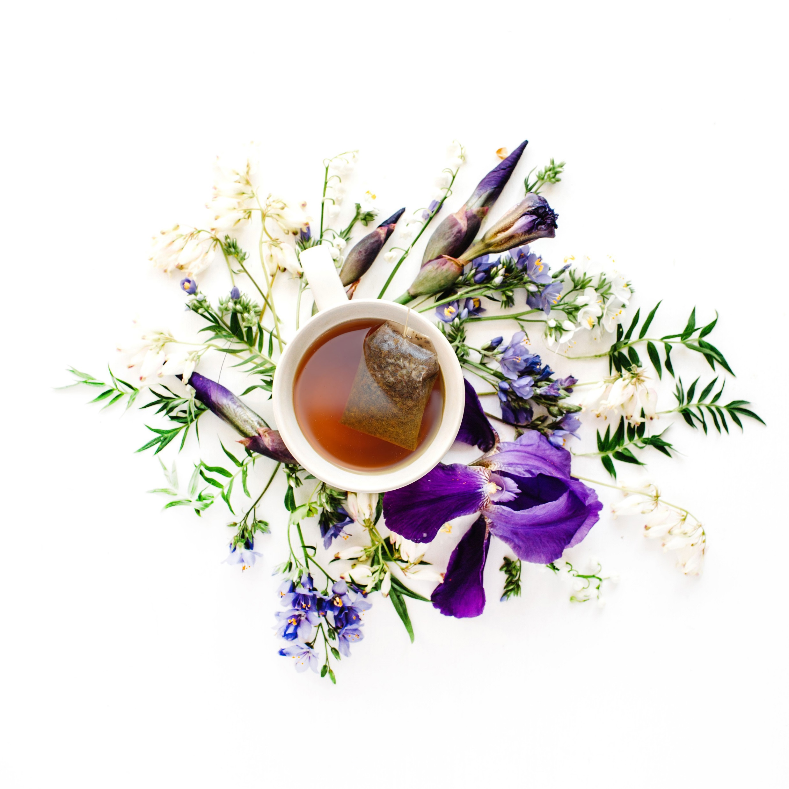
HerbalScience Utility Usage KPI
Utility usage was calculated by applying the Herbal Science LLC. square footage ratio to the monthly total building utility usage.
Landlord does not track usage by individual lessee.
Type /Units | 2020 | 2019 | Increase/ Decrease | Increase/ Decrease %
Electricity (kWH) | 43,194 | 39,430 | (3,734) | (8.7%)
Gas (CCF) | 266 | 326 | 61 | 22.9%
Water (CCF) | 63 | 57 | (6) | (10.0%)

Slide 3
HerbalScience LLC Compensation KPI
US Average Salary Per Robert Half 2021 Guide, for all but corporate Counsel with local market adjustments or Salary.com.
All salaries within 5% of local market salaries.
Salaries for all categories significantly above local minimum wage.
Position Type | HS 2020 Salary as a % of 2020 Market Salary | HS Salary as a % of Local Minimum Wage
Salary – Not management | 104% | 264%
Salary Managerial | 99% | 297%
Salary Professional | 95% | 663%

Slide 4
HerbalScience - Education and training KPIs
Training conducted to increase job related technical skills and to broaden personal growth and development
Training conducted with both in-house materials and trainers and with certificate providing professional trainers
 | 2020 | 2019
Total Hours of Training | 209 | 99
Average Hours of training per Employee | 52 | 33

Slide 5
HerbalScience - Accident Frequency rate KPIs
All workers are on a salary basis, Total hours worked is calculated based on 40 hour weeks for the number of weeks employed during the year.
Accident frequency rate = (number of lost time injury) x (1,000,000/total hours worked)
Accident severity rate = (days lost to injury) x (1,000/hours worked)
 | Hours |  | Frequency/Severity Rate
 | 2020 | 2019 | 2020 | 2019
Hours missed to workplace injury (frequency) | 0 | 0 | 0 | 0
Days missed due to injury (severity) | 0 | 0 | 0 | 0
Total hours worked | 8,160 | 6,240

Slide 6
HerbalScience - Absenteeism rate KPIs
Absenteeism rate =days lost to non-work related illness /scheduled working days x 100
CEO data excluded from the calculation
 | Days missed |  | Absenteeism rate
 | 2020 | 2019 | 2020 | 2019
Days missed due to non-work related illness | 5 | 0 | .51 | 0
Total scheduled work days | 964 | 756

Slide 7
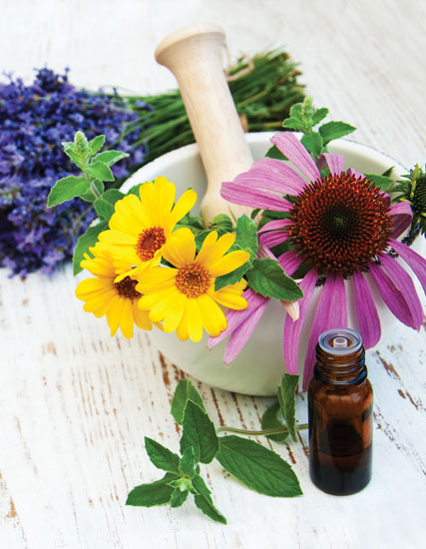
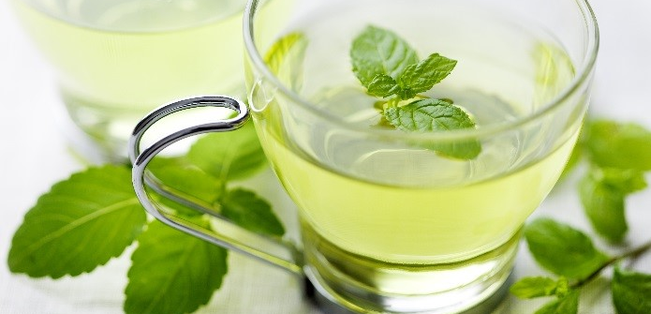
Manufacturing Certifications
Our commercial manufacturing facility (Alkaloid AD) is:
GMP compliant
FDA registered
FSSC 22000 certified (complying with the requirements of Food Safety System Certification)
ISO 9001:2000 certified (complying with the requirements of the Quality Management System Standard)
ISO 14001:2004 certified (complying with the requirements of the Environmental Management System Standard)
HACCP (Hazard Analysis of Critical Control Points) certified
Certified for Organic Production according to the: USDA/NOP, EU 2091/91, and JAS (Japan)

Slide 8
Contact Us
Vera Stavroff
President & CEO
vstavroff@herbalscienceinc.com
HerbalScience, Inc.
6530 W Campus Oval, Suite 280
New Albany, OH 43054
614-939-9488
www.herbalscienceinc.com

